Slide 1
A Comparative Illustration of Trip- and Activity-Based Modelling Techniques
Hayden Atchley
Committee:
Greg Macfarlane (chair)
Grant Schultz
Gustavious Williams

Slide 2
Introduction
Activity-based models considered superior
Focus on theoretical benefits
Lack of discussion of practical benefits
This research addresses the practicality of activity-based models
Not focused necessarily on model accuracy
Intended for agencies considering switching models
Three scenarios
Land use change
Infrastructure change
Behavior change

Slide 3
Overview of Model Types
Trip-based model
Aggregate population data, by TAZ
Number of households/people
Average income
Number of workers
Trips modeled at TAZ level
Activity-based model
Synthetic population
Individual households/people
Individual income
Worker status
Trips modeled individually
Trips organized into “tours”

Slide 4
Difficulties with Activity-Based Models
Computational inefficiency
More data in activity-based model
Longer runtimes/more resources required
Complicated design
More steps
Complicated choice models
Lack of interoperability
Models specific to an area

Slide 5
Methods
Representative trip-based model: WFRC Model
Current production model for WFRC
Implemented in CUBE software
Representative activity-based model: ActivitySim
Non-production, research implementation
Same model area as WFRC model
Synthetic population from PopulationSim
Network skims from WFRC model

Slide 6
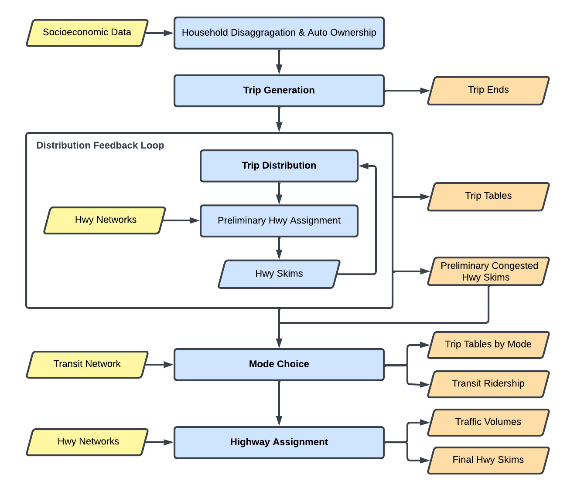
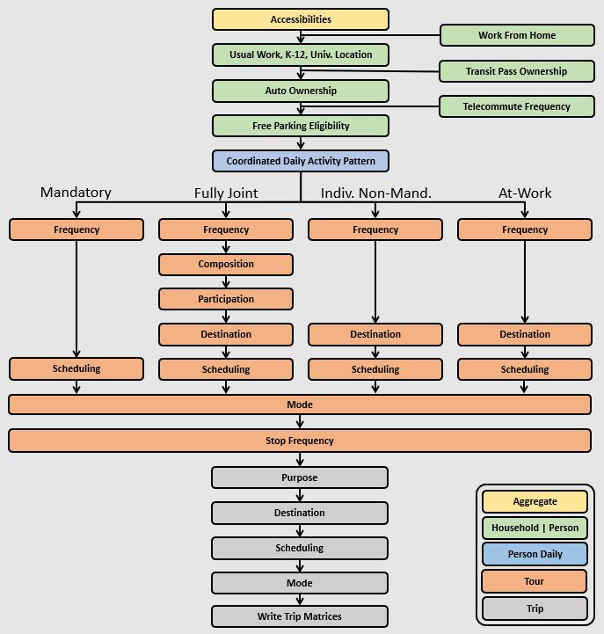
Model Flowcharts
WFRC Model
ActivitySim
Notes:
Introduce validation/calibration

Slide 7
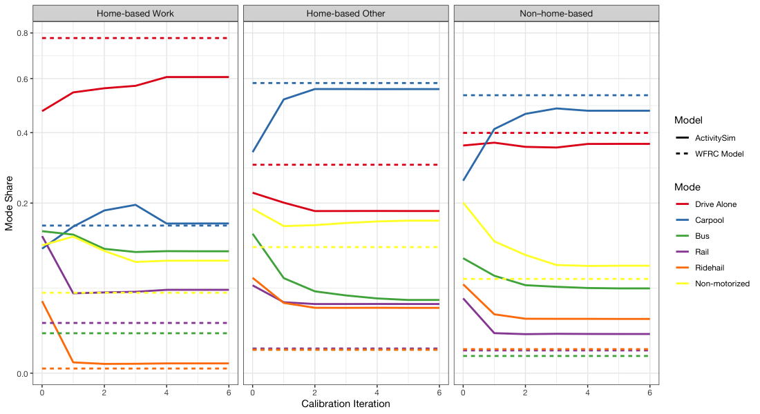
Mode Choice Calibration
Notes:
We used Iteration 4.
We also validated on district population, income, TLFD, and remote work.

Slide 8
Scenarios Overview
Land Use Scenario | Transit Scenario | Remote Work Scenario
New development at old Draper prison site Projected 2050 SE data for The Point Utah | Increase frequency and speeds of FrontRunner New Frontrunner stations Based on WFRC 2050 plan | Higher WFH and telecommute Calibrated to WFRC 2050 projections

Slide 9
Land Use Scenario
WFRC Model:
Changed land use data for The Point area (Draper)
Match 2050 data
7,430 New Households
22,200 New Employments
ActivitySim:
Updated PopulationSim
Re-run only The Point area
New Census targets from Gateway area (SLC)
Joined with base year population

Slide 10
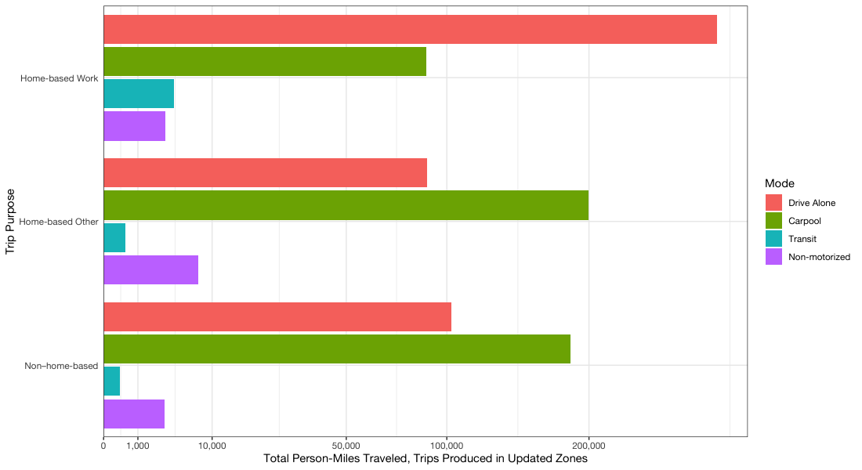
WFRC: Person-miles

Slide 11
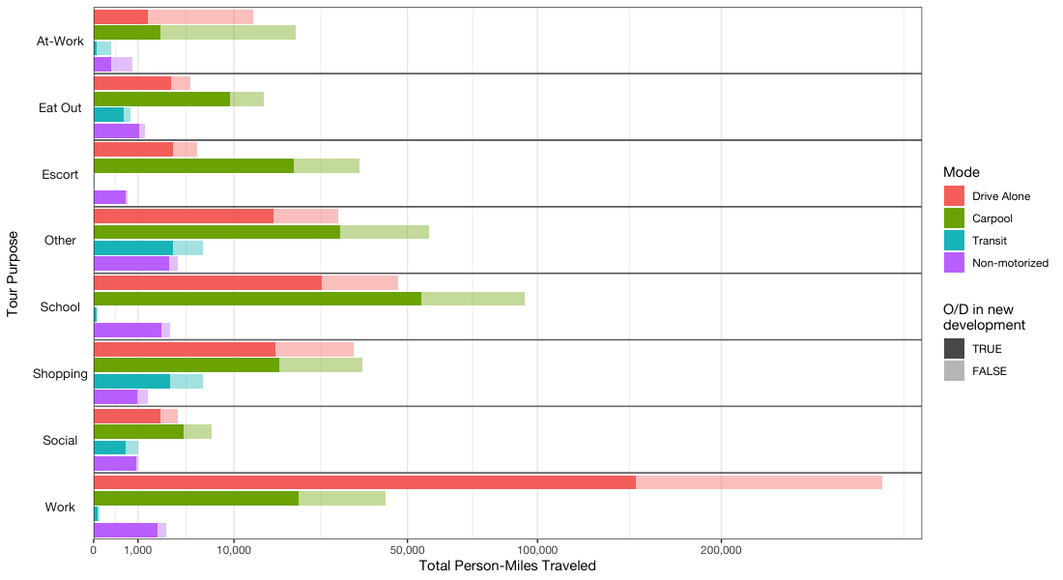
ActivitySim: Person-miles

Slide 12
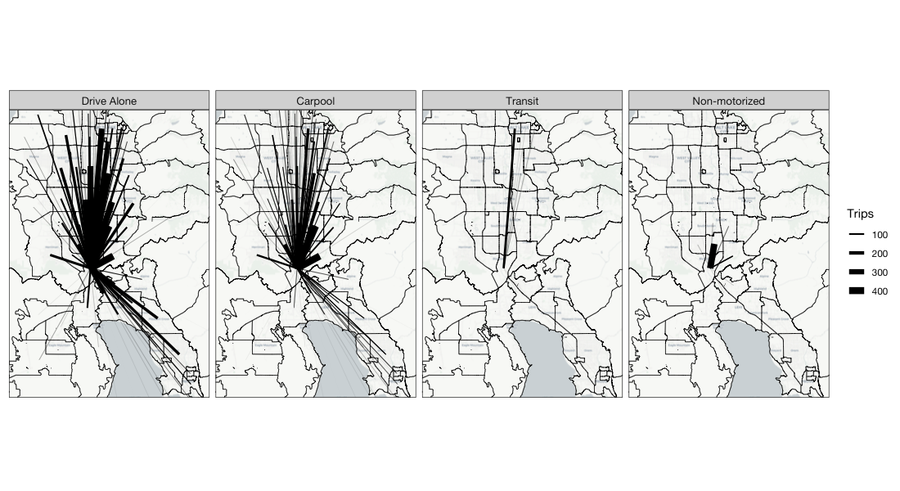
WFRC: Home-Based Trips

Slide 13
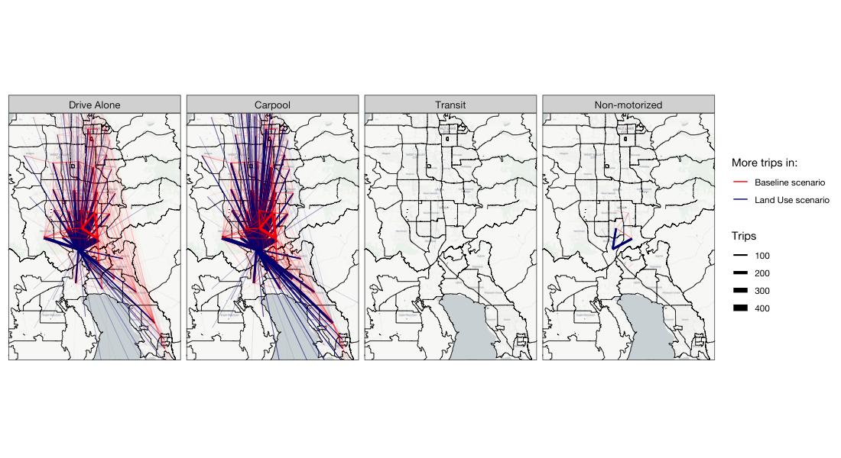
WFRC: Non–Home-Based Trips

Slide 14
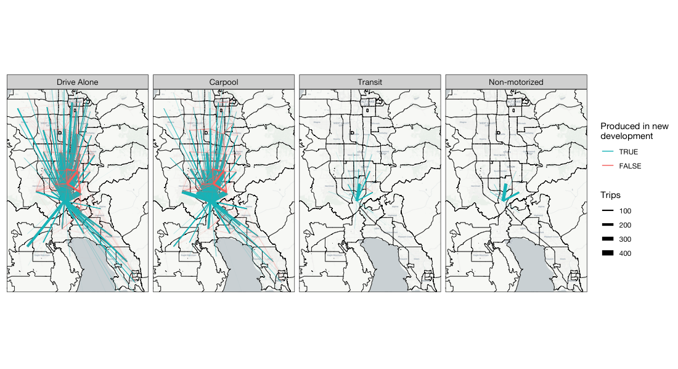
ActivitySim: New Resident Trips

Slide 15
Transit Scenario
WFRC Model:
Adjusted FrontRunner headways from 60/30 to 30/15
Used future speed and track extensions
Additional stations in Vineyard, Springville, Spanish Fork, and Payson
ActivitySim
New skims from CUBE

Slide 16
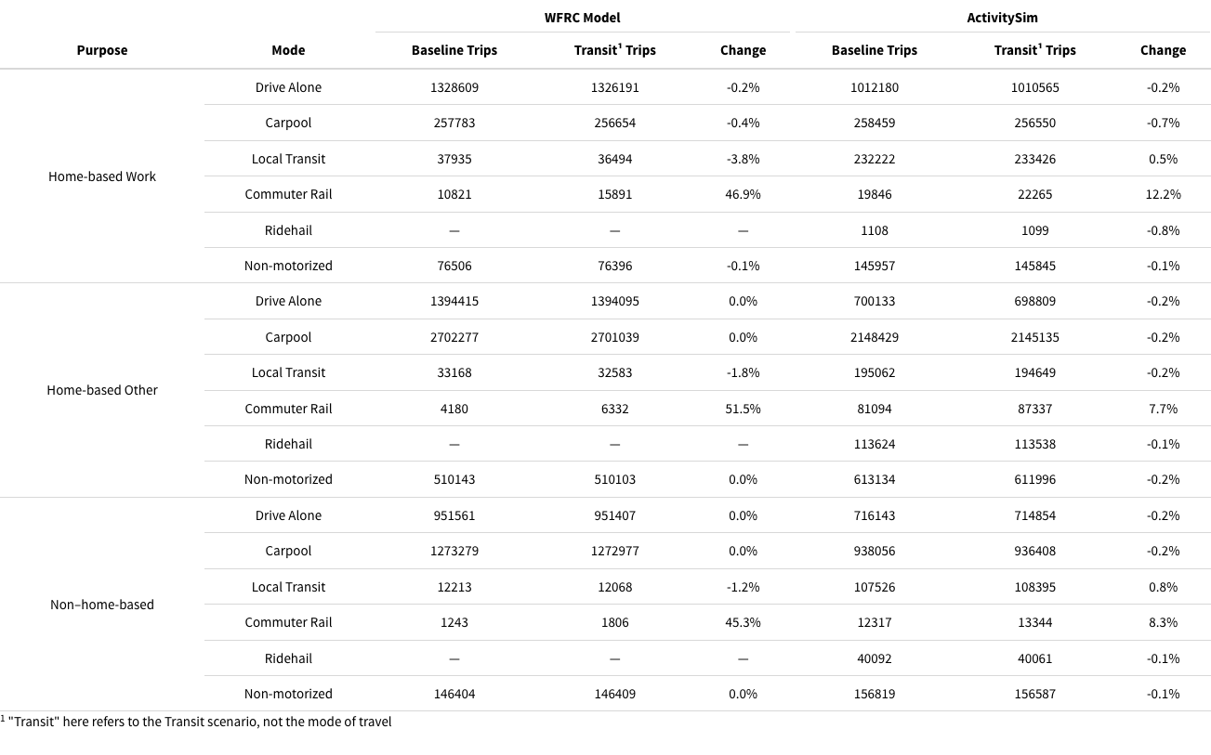
Change in Mode Split

Slide 17
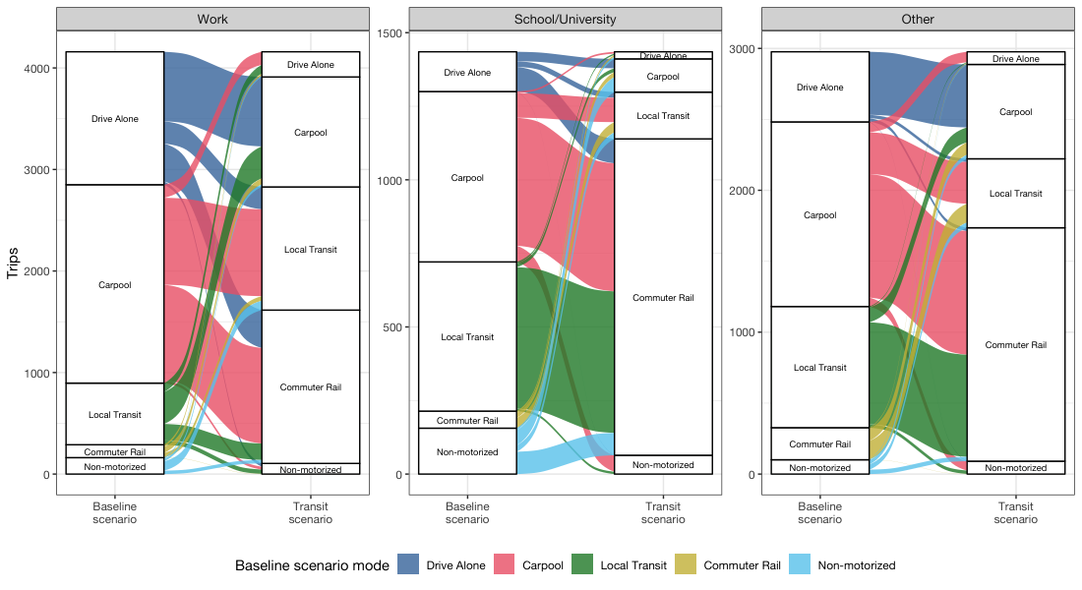
Mode Switching

Slide 18
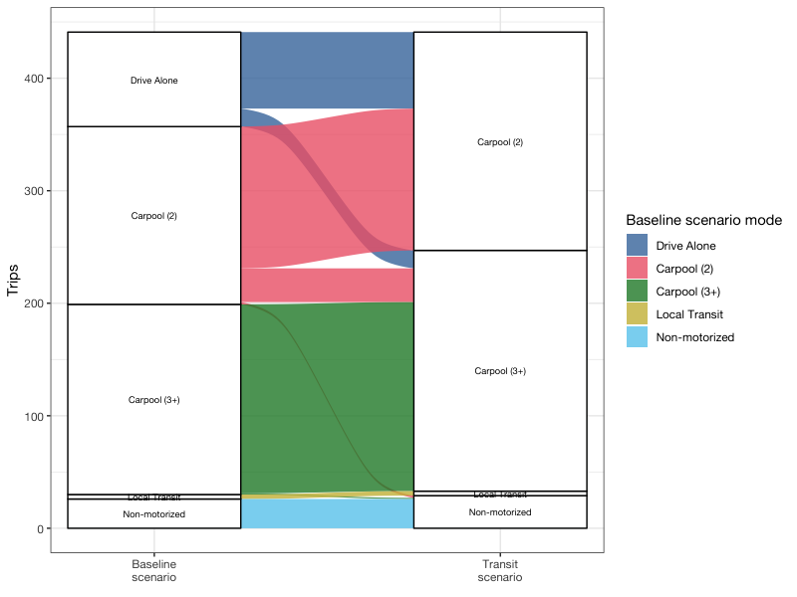
At-Work Mode Switching
Notes:
At-work trip modes of those who switched away from Drive Alone for work tours

Slide 19
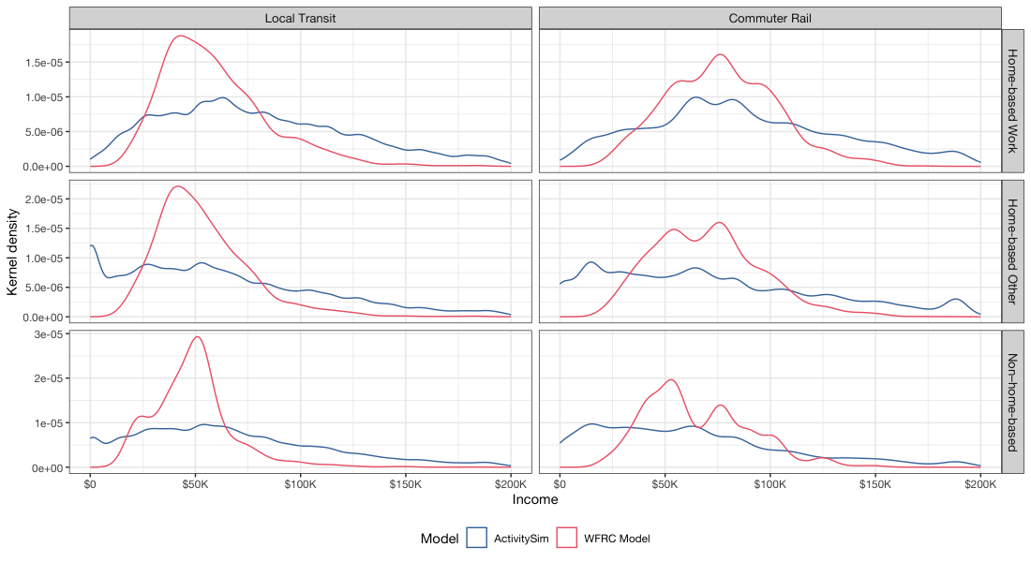
Transit Riders Income Distribution
Notes:
The WFRC Model is a distribution of (weighted) medians (see previous slide), and ActivitySim is a distribution of actual individual incomes.

Slide 20
Remote Work Scenario
WFRC Model:
Used 2050 remote work rates
WFH average increase from 2.9% to 3.5%
Telecommute average increase from 3.7% to 10.2%
ActivitySim:
Recalibrated remote work to WFRC 2050 rates
WFH matches WFRC data
Telecommute matches % by job type

Slide 21
Remote Work Considerations
“Rebound effect”
Fewer work trips may cause more non-work trips
Trip length
Longer commute more likely to work remotely
Drop long, work trips in favor of shorter, non-work trips

Slide 22
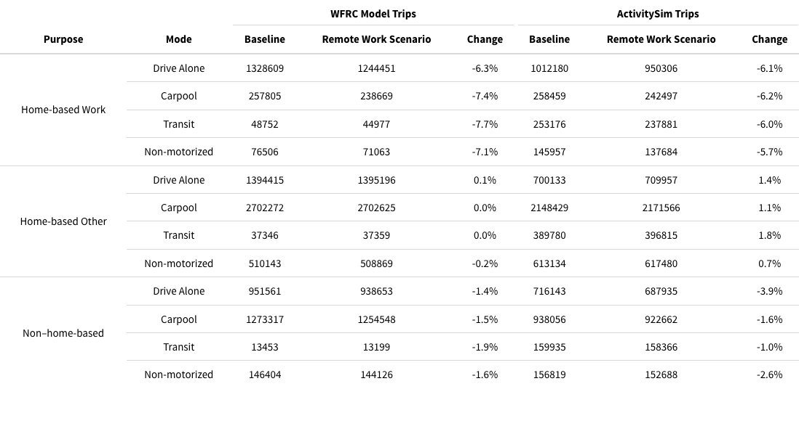
Change in Number of Trips
Notes:
The ABM has a “rebound effect” where there are mode HBO trips as a result of the increased remote work

Slide 23
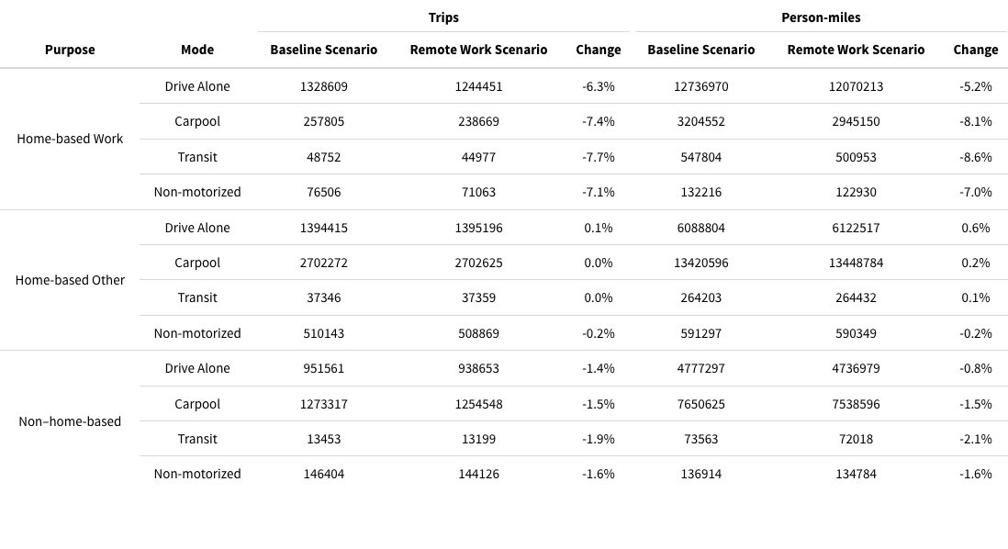
WFRC: Trip Count vs Length
Notes:
For drive alone HBW trips, the % decrease in number was greater than in distance. This shows that on average shorter HBW trips were “dropped” with increased remote work.

Slide 24
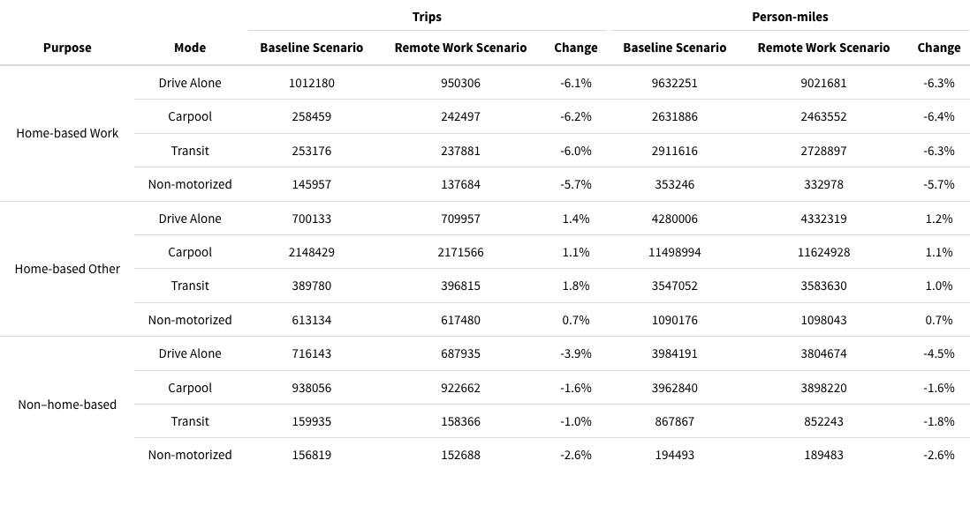
ActivitySim: Trip Count vs Length
Notes:
Work trips show more decrease in length than in number of trips. This shows that longer work trips are being “dropped”, perhaps in exchange for shorter HBO trips.

Slide 25
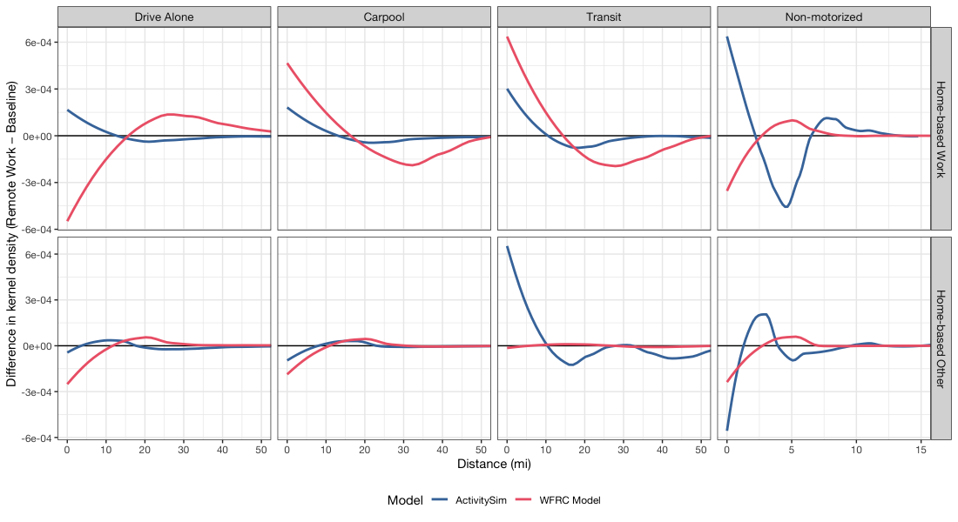
Difference in Trip Length Distribution
Notes:
With increased remote work, the trip length frequency distribution changes. ActivitySim generally shows that work trips are shorter on average, while the WFRC model does not.

Slide 26
Conclusions
Computationally similar
Similar runtime on same hardware
Model complexity
ActivitySim easier to interpret
Non–home-based trips
Each step simply assigns a value to household/individual
Trip-based aggregate data harder to interpret
Interoperability/extensibility
ActivitySim remote work sub-models taken from SEMCOG
Simple to add/edit parameters
Cited difficulties may not be applicable!
Notes:
Limitless number of analyses, these are only examples. But for the same effort, more in-depth analysis with ActivitySim

